Slide 1
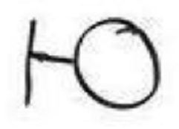
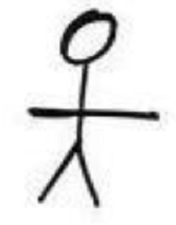
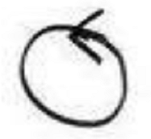
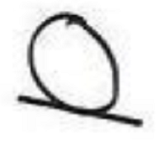
As a user, I want to login to donation tracker, so that I can view the donation info.
Error message: failure: forget password /incorrect username
(Interface)
User
(Actor)
Log In
(Interface)
Log In
(Controller)
Main page
(Controller)
Log In Result
(Interface)
Account Storage
(Domain)

